Slide 1

Week 1 Presentation
Zongxian Feng

Slide 2
Content
1
MAG dataset
2
The Announcement
Aminer
CrossRef
Dimensions
lens.org
OpenCitations
Scopus
Semantic Scholar
3
Candidates
4
Comparing

Slide 3
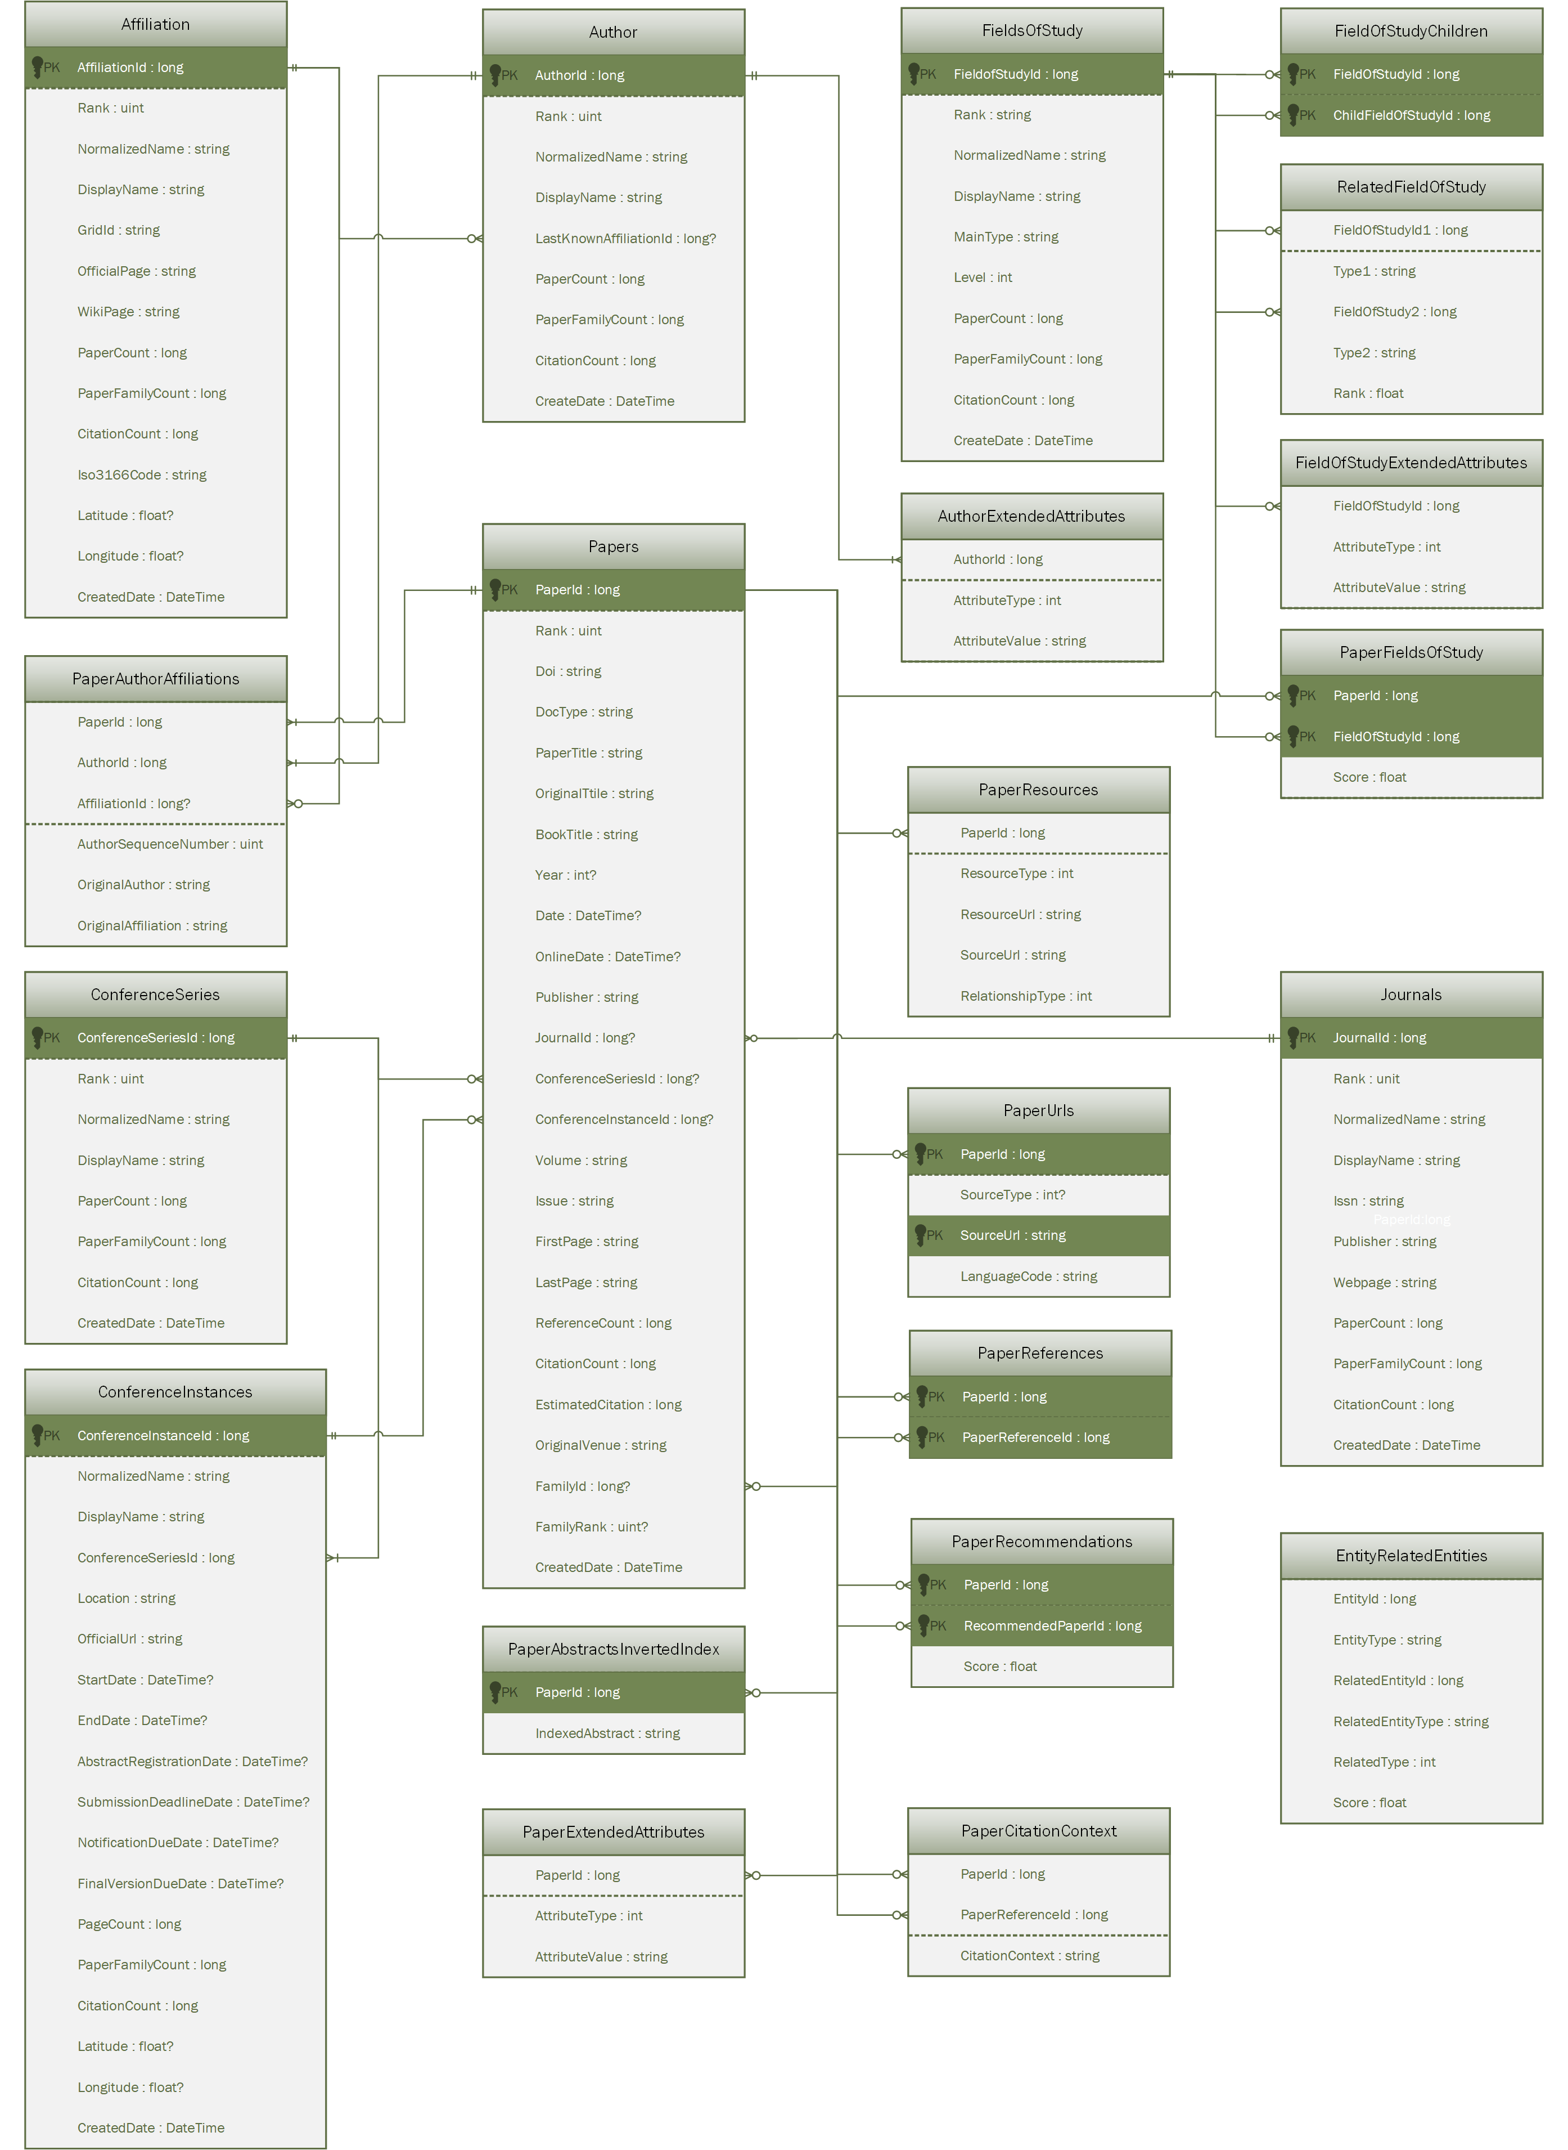
MAG datasets
What is this dataset about?
The MAG is a heterogeneous graph containing scientific publication records, citation relationships between those publications, as well as authors, institutions, journals, conferences, and fields of study
Notes:
https://docs.microsoft.com/en-us/academic-services/graph/reference-data-schema
https://docs.microsoft.com/en-us/academic-services/graph/media/erd/entity-relationship-diagram.png

Slide 4
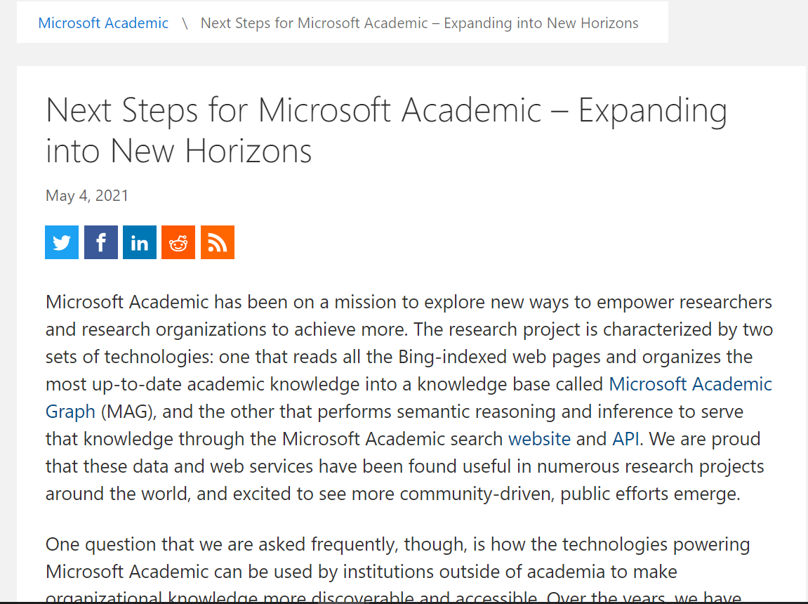
The Announcement May 4, 2021
Summarization:
Microsoft Academic wants to extend their this technology to new domain besides academia. So the MAG is going to retire at the end of 2021.
There are some alternative platforms:
Aminer
CrossRef
Dimensions
lens.org
OpenCitations
Scopus
Semantic Scholar

Slide 5
Content
1
MAG dataset
2
The Announcement
AMiner
CrossRef
Dimensions
lens.org
OpenCitations
Scopus
Semantic Scholar
3
Candidates
4
Comparing

Slide 6
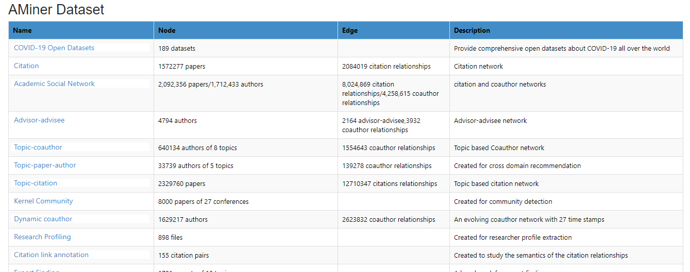
AMiner
Platform Overview:
Creating a semantic-based profile for each researcher by extracting info from the distributed Web
Integrating academic data from multiple sources
Accurately searching the heterogenous network
Analyzing and discovering interesting patterns from the built researcher network
Datasets Overview:
Researchers | 133,171,189
Publications | 319,341,578
Concepts | 8,796,579
Citations | 1,121,295,724
Notes:
https://www.aminer.cn/data/?nav=openData
https://www.aminer.cn/introduction
https://www.aminer.cn/

Slide 7
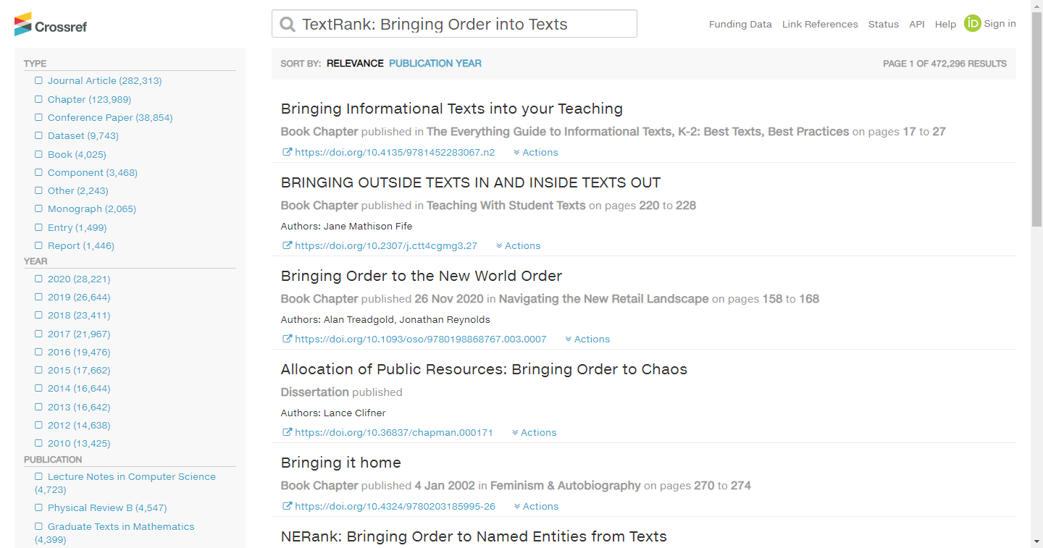
CrossRef
Platform Overview:
We process it so that connections can be made between publications, people, organizations, and other associated outputs. We preserve the metadata we receive for the scholarly record. We also make it available across a range of interfaces and formats so that the community can use it and build tools with it.
2 ways to access metadata:
API
Search Engine
Use API to access metadata
Notes:
https://www.crossref.org/services/
https://search.crossref.org/?from_ui=&q=TextRank%3A+Bringing+Order+into+Texts
Unable to find a description of datasets

Slide 8
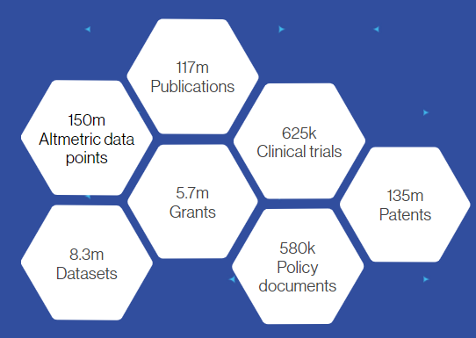
Dimensions
Data overview
Platforms Overview:
Dimensions indexes data from a myriad of sources so that you can track and understand the complete research cycle.
Notes:
https://www.dimensions.ai/dimensions-data/

Slide 9
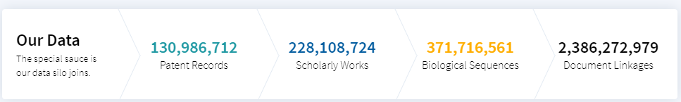
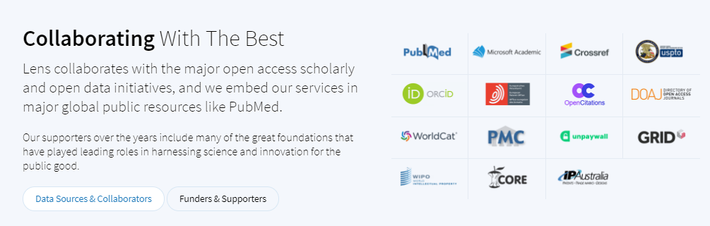
lens.org
Platform Overview:
Patent Search and analysis
Scholarly search and analysis
discover experts & collaborators
Mapping influence of scholarship
collections and portfolios
explore biological sequences
lens profile
Data overview
Notes:
https://www.lens.org/?locale=zh

Slide 10
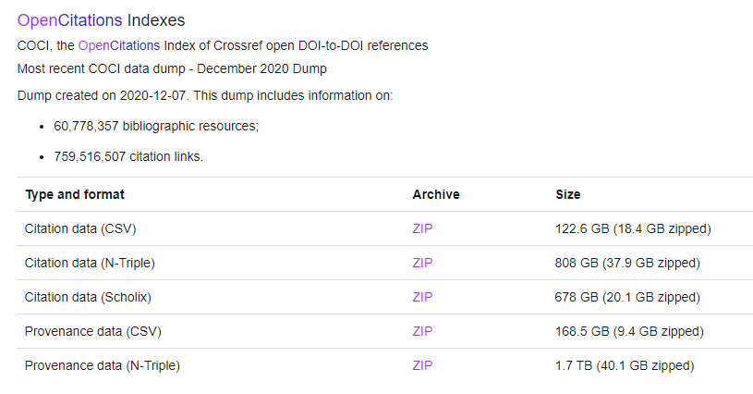
OpenCitations
Platform Overview:
OpenCitations is an independent not-for-profit infrastructure organization for open scholarship dedicated to the publication of open bibliographic and citation data by the use of Semantic Web (Linked Data) technologies
Data overview：
Notes:
https://opencitations.net/datasets

Slide 11
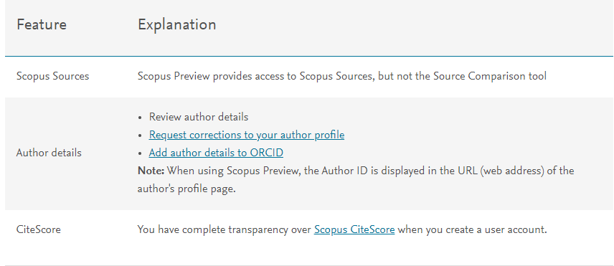
Scopus
Platform Overview:
Scopus is the world's largest abstract and citation database of peer-reviewed research literature. With over 22,000 titles from more than 5,000 international publishers.
Citescore methodology is amazing
Dataset overview：
Scopus Preview Schema
Notes:
https://service.elsevier.com/app/answers/detail/a_id/15534/supporthub/scopus/#tips
https://www.scopus.com/sources?zone=TopNavBar&origin=NO%20ORIGIN%20DEFINED
https://www.scopus.com/freelookup/form/author.uri?zone=TopNavBar&origin=NO%20ORIGIN%20DEFINED

Slide 12
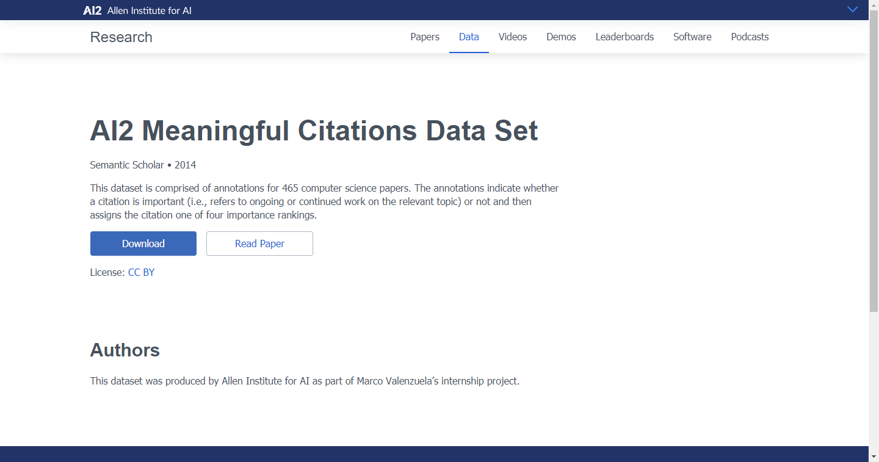
Sematic Scholar
Platform Overview:
Semantic Scholar is a free, AI-powered research tool for scientific literature, based at the Allen Institute for AI.
TLDRs: Extreme paper summaries in 1 sentence
Datasets overview:
Datasets are classified into 62 categories.
Notes:
https://allenai.org/data

Slide 13
Parallel Comparison
 | AMiner | CrossRef | Dimensions | lens.org | OpenCiations | Scopus | Sematic Scholar
Friendly platform | √ | √ | √ | √ |  |  | √
Good Search Engine | √ | √ | √ | √ |  | √ | √
Datasets Downloadable | √ | JSON | API | API | √ |  | √
Similar Relational Schema as MAG | √ |  | √ | √
Do not need an account |  |  |  |  | √
Size of citations Datasets(1 is the largest) | 3 |  | 1 | 2 | 4

Slide 14
References
https://www.microsoft.com/en-us/research/project/academic/articles/microsoft-academic-to-expand-horizons-with-community-driven-approach/
https://docs.microsoft.com/en-us/academic-services/graph/reference-data-schema
https://docs.microsoft.com/en-us/academic-services/graph/media/erd/entity-relationship-diagram.png
https://www.aminer.cn/data/?nav=openData
https://www.aminer.cn/introduction
https://www.aminer.cn/
Notes:
在“幻灯片放映”模式下，选择箭头访问相应链接。

Slide 15
References
https://www.crossref.org/services/
https://search.crossref.org/?from_ui=&q=TextRank%3A+Bringing+Order+into+Texts
https://www.dimensions.ai/dimensions-data/
https://www.lens.org/?locale=zh
https://opencitations.net/datasets
Notes:
在“幻灯片放映”模式下，选择箭头访问相应链接。

Slide 16
References
https://service.elsevier.com/app/answers/detail/a_id/15534/supporthub/scopus/#tips
https://www.scopus.com/sources?zone=TopNavBar&origin=NO%20ORIGIN%20DEFINED
https://www.scopus.com/freelookup/form/author.uri?zone=TopNavBar&origin=NO%20ORIGIN%20DEFINED
https://allenai.org/data
Notes:
在“幻灯片放映”模式下，选择箭头访问相应链接。

